Slide 1

MADHAV INSTITUTE OF TECHNOLOGY AND SCIENCE GWALIOR (M.P)
CENTER FOR ARTIFICIAL INTELLIGENCE
MINOR PROJECT (280604)
Automatic License Plate Recognition
Submitted by:
Eshita Nagariya
(0901AM211023) Surabhi Verma
(0901AM211059)
Guided by:
Prof. Geetika Hazra

Slide 2
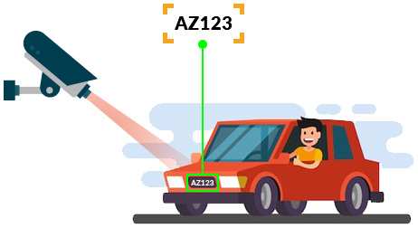
INTRODUCTION
Automatic License Plate Recognition (ALPR) systems have gained significant attention in recent years due to their wide range of applications in law enforcement, traffic management, and security surveillance.
In this work we introduces an Automatic License Plate Recognition (ALPR) system leveraging EasyOCR and YOLO (You Only Look Once) algorithms.
The proposed system integrates EasyOCR for optical character recognition (OCR) and YOLO for license plate detection, utilizing the efficiency and accuracy of these technologies.
Fig1. Automatic License Plate Recognition System

Slide 3
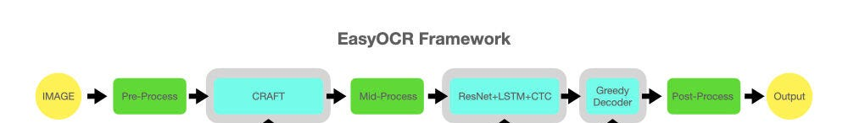
EasyOCR
EasyOCR is a Python library that provides a simple interface for performing Optical Character Recognition (OCR) on images. It's built on top of other OCR engines and offers easy integration into Python projects. With EasyOCR, you can extract text from images with minimal code and configuration, making it ideal for quick OCR tasks and prototyping.
Fig2. EasyOCR Framework

Slide 4
YOLO (You Only Look Once)
Single-pass Object Detection: YOLO performs object detection in a single forward pass of a neural network, making it faster and more efficient compared to traditional multi-stage approaches.
Grid-based Prediction: YOLO divides the input image into a grid and predicts bounding boxes and class probabilities directly for each grid cell, simplifying the detection process.
Real-time Applications: YOLO is well-suited for real-time applications such as video surveillance, autonomous driving, and robotics due to its speed and accuracy, making it a popular choice for various computer vision tasks.

Slide 5
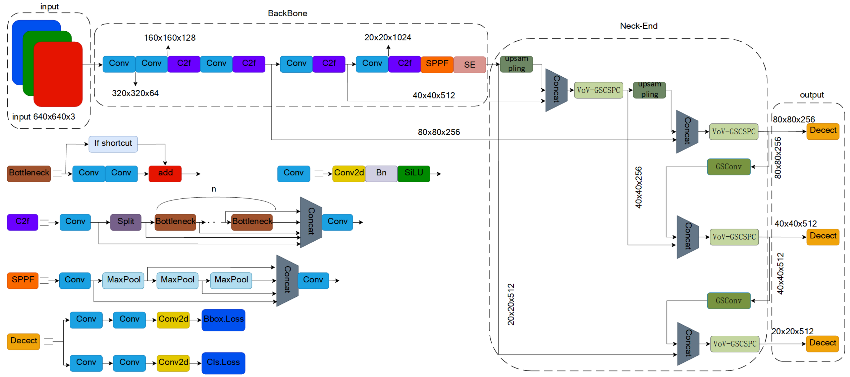
Fig3. YOLOv8 Architechture

Slide 6
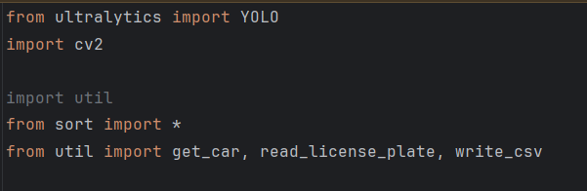
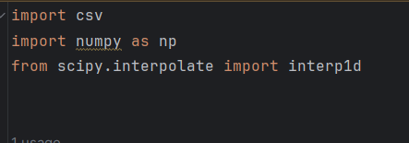
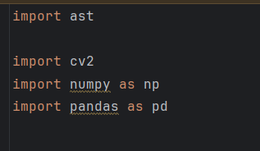
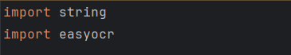
Libraries Used
(a) main.py
(c) add_missing_data.py
(d) visualize.py
(b) util.py
Fig4. Libraries used in (a), (b), (c) and (d)

Slide 7
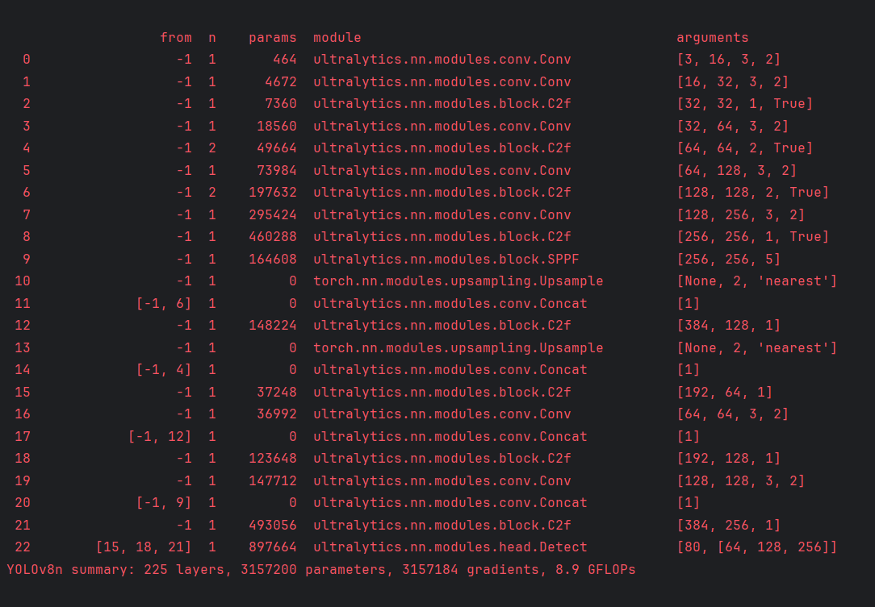
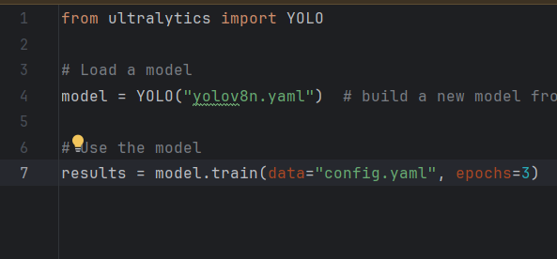
Feature Extraction using YOLOv8
Fig5. Re-training the Model
Fig 6. Summary of Model

Slide 8
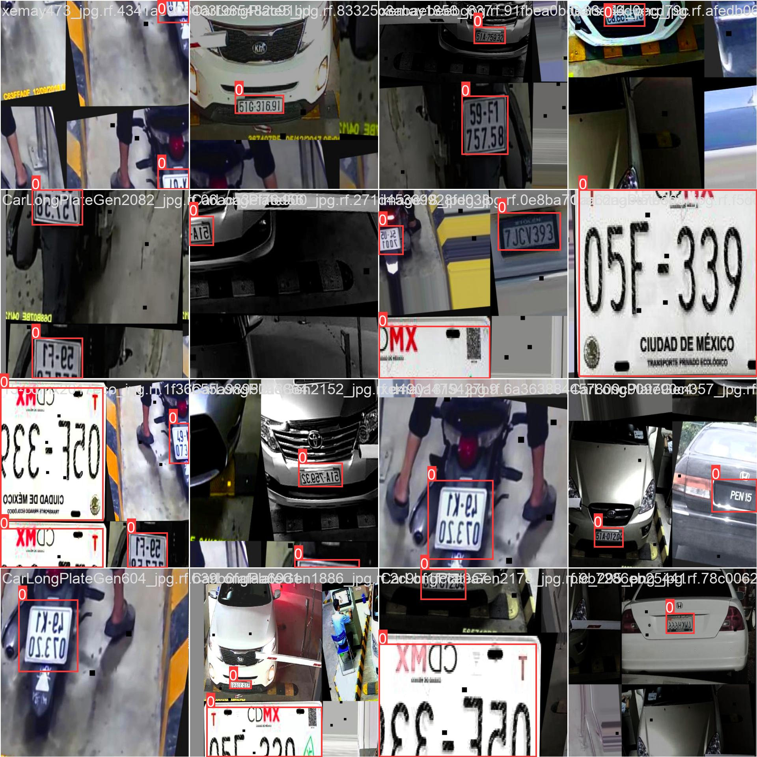
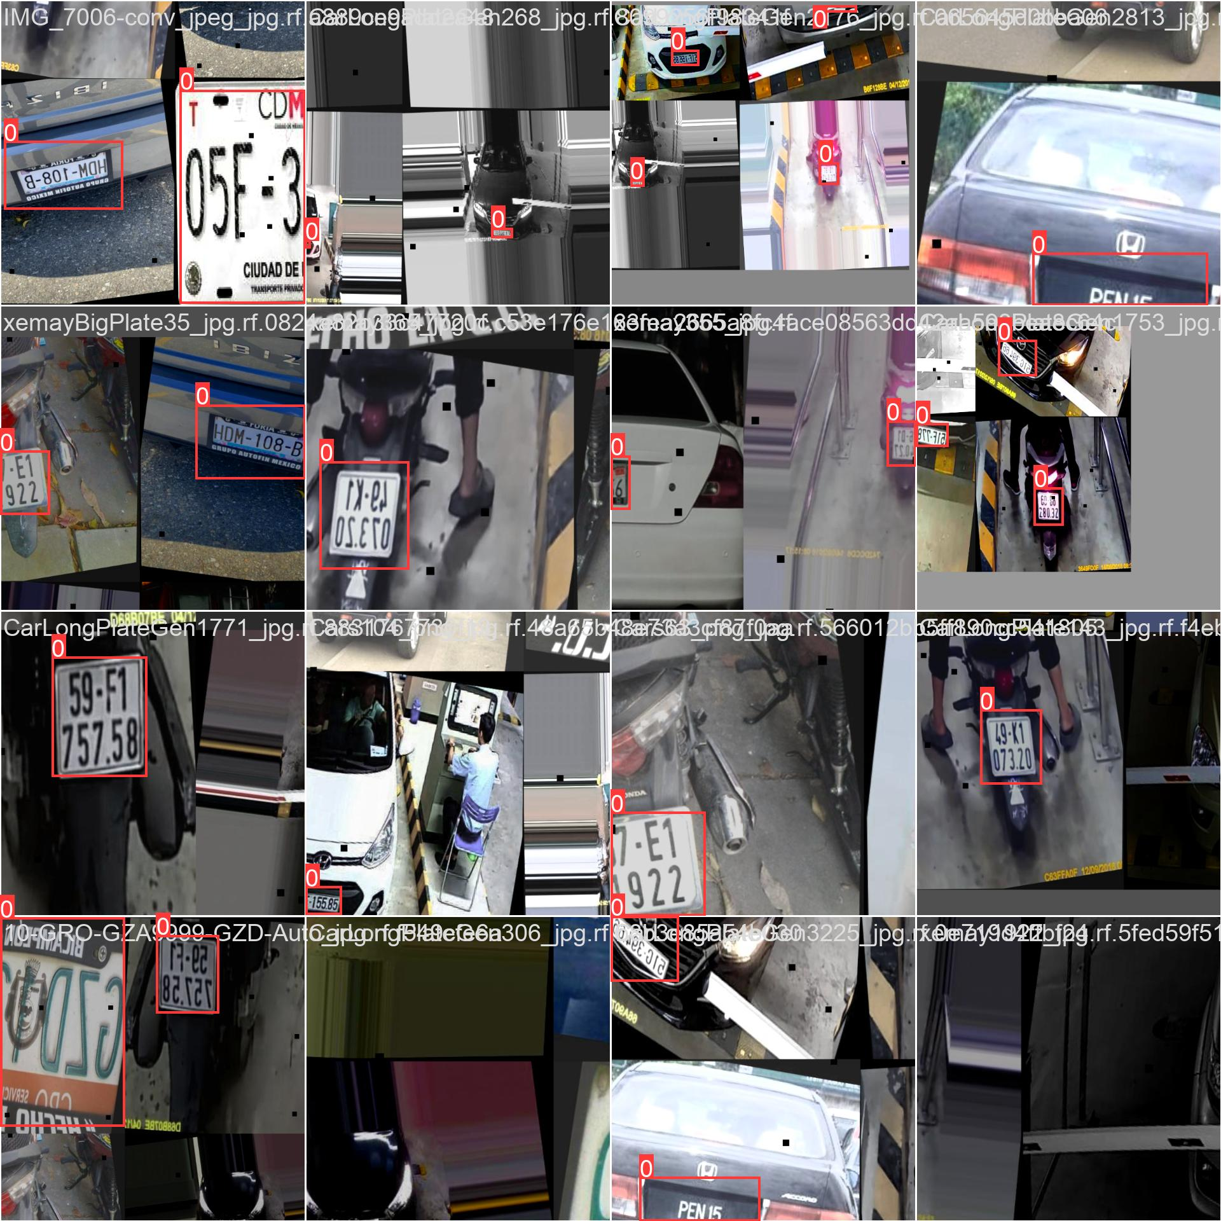
Model Visualization
Fig7. Test Result Visualization

Slide 9
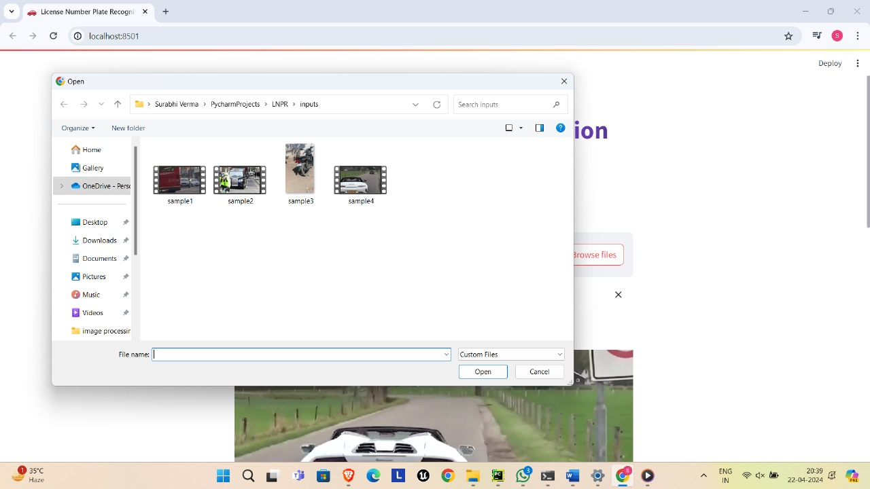
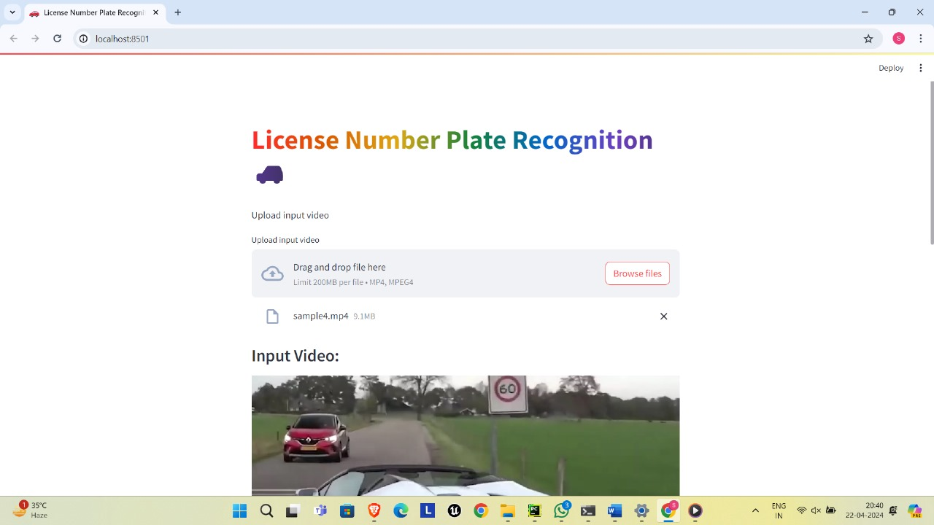
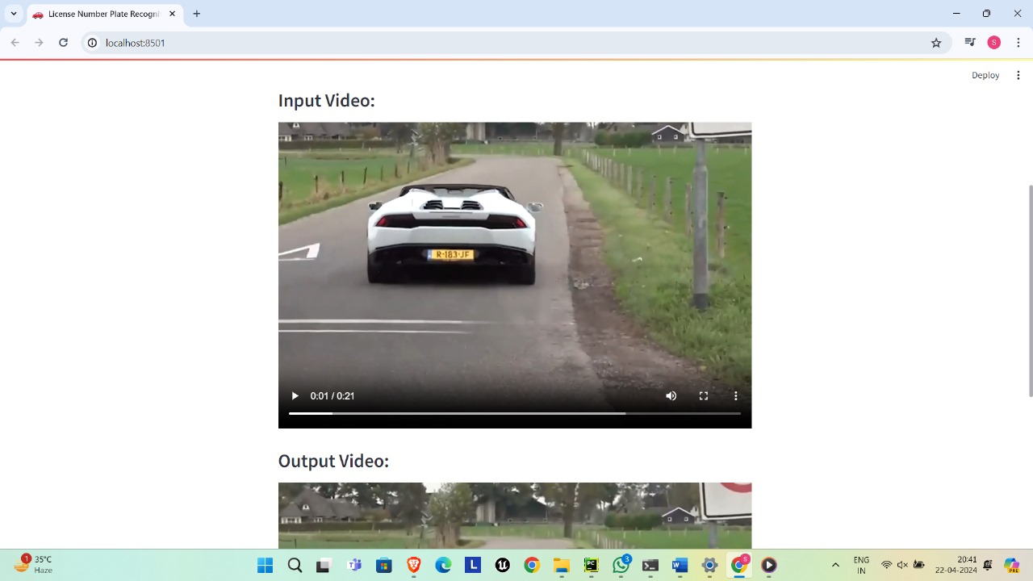
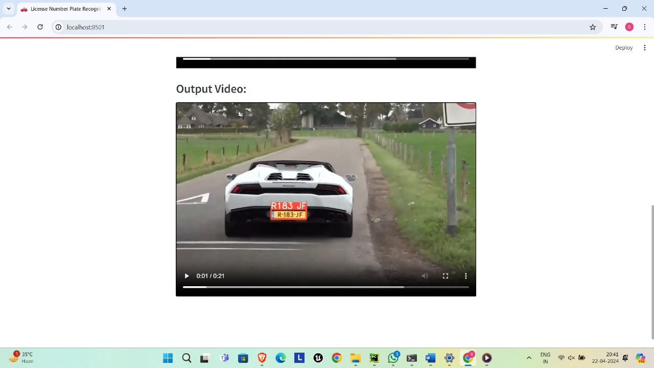
User Interface using Streamlit

Slide 10
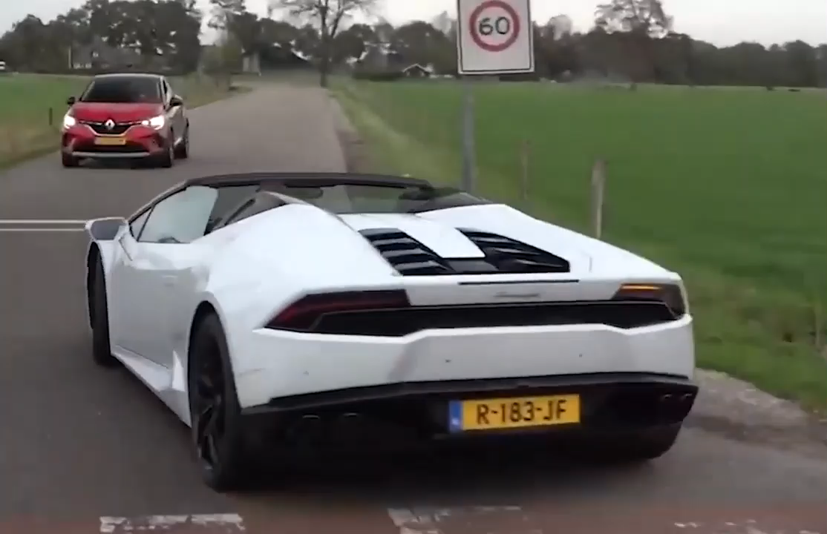
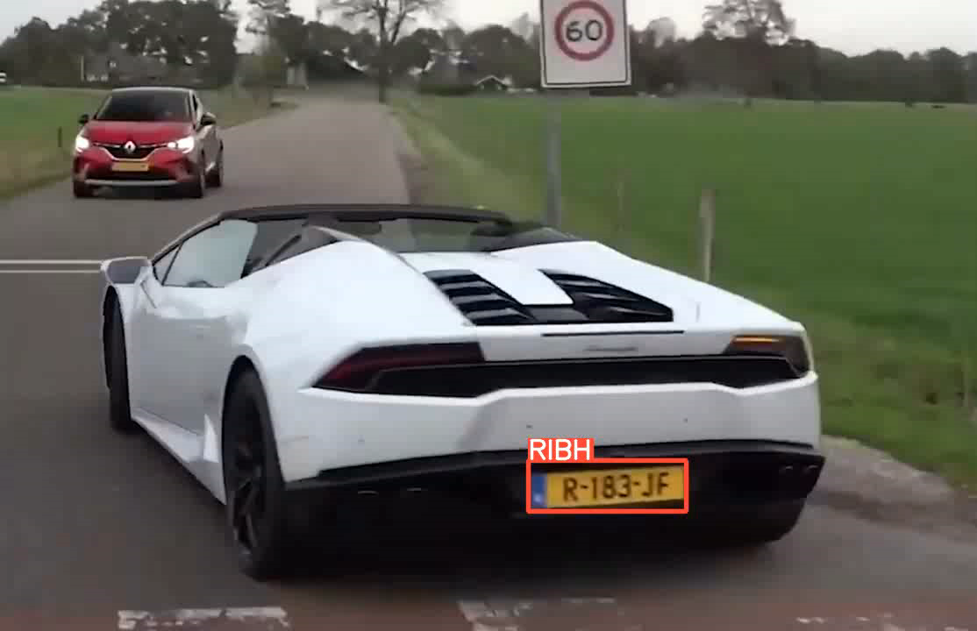
Input and Output Videos
INPUT
OUTPUT
Video1. Input Video
Video2. Output Video

Slide 11
Model Evaluation
Evaluation Metric | Measure
train/box_loss | 2.103
train/cls_loss | 2.2096
train/dfl_loss | 2.4839
metrics/precision(B) | 0.921
metrics/recall(B) | 0.801

Slide 12
Future Scope
Enhanced Accuracy and Robustness: Focus on improving accuracy and robustness through deep learning techniques, novel architectures, and data augmentation methods.
Integration with Smart City Infrastructure: ALPR systems merge with intelligent transportation systems for real-time monitoring, congestion management, and safer urban environments.
Privacy-Preserving Solutions: Implement on-device processing, anonymization, and encryption to ensure compliance with privacy regulations and protect individuals' data.
Real-time Analytics and Decision Support: ALPR systems offer real-time analytics and decision support for traffic management, toll collection, and parking optimization using machine learning algorithms.

Slide 13
Application
Law Enforcement:
Identify and track vehicles involved in criminal activities.
Automate toll collection and identify vehicles with outstanding fines.
Traffic Monitoring:
Real-time tracking for traffic flow analysis.
Automated detection of traffic violations.
Access Control:
Secure entry points by recognizing authorized vehicles.
Enhanced security in gated communities and restricted areas.
Parking Management:
Automated entry and exit systems in parking lots.
Efficient utilization of parking spaces.

Slide 14
Limitations
Environmental Challenges: ALPR systems encounter issues with poor lighting, damaged plates, and variations in plate designs across regions, affecting recognition accuracy.
Operational Limitations: High-speed and congested traffic scenarios pose challenges for ALPR systems to accurately identify plates, impacting overall effectiveness.
Privacy Concerns: Ethical considerations arise from privacy concerns related to the collection and storage of license plate data, prompting the need for privacy-preserving solutions.
Standardization and Reliability: Lack of standardization in license plate formats and potential system errors contribute to the need for ongoing refinement in ALPR technology.

Slide 15
Conclusion
The integration of YOLOv8 for object detection and EasyOCR for text recognition in automatic license plate recognition (ALPR) systems offers a powerful solution for accurately identifying license plates from images or video streams. YOLOv8 efficiently detects vehicles and localizes license plates, while EasyOCR accurately extracts text from these regions. This combined approach enables robust and real-time ALPR systems with high accuracy and versatility

Slide 16
References
[1] Telaumbanua, Agustritus Pasrah Hati, et al. "Vehicle Detection and Identification Using Computer Vision Technology with the Utilization of the YOLOv8 Deep Learning Method." Sinkron: jurnal dan penelitian teknik informatika 8.4 (2023): 2150-2157.
[2] Jain, Parth Hasmukh, et al. "Artificially Intelligent Readers: An Adaptive Framework for Original Handwritten Numerical Digits Recognition with OCR Methods." Information 14.6 (2023): 305.
[3]https://universe.roboflow.com/roboflow-universe-projects/license-plate-recognition-rxg4e/dataset/4

